Slide 1
Superstore dataset

Slide 2
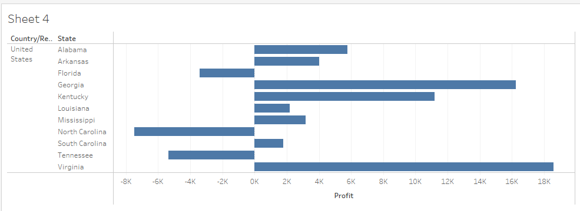
Represent the profit map in horizontal bar format.

Slide 3
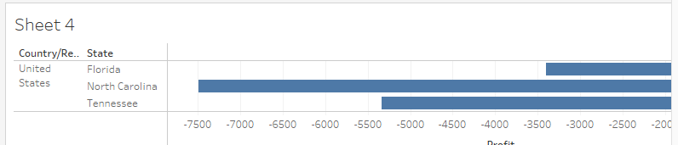
Show only the states having negative profit in the bar graph

Slide 4
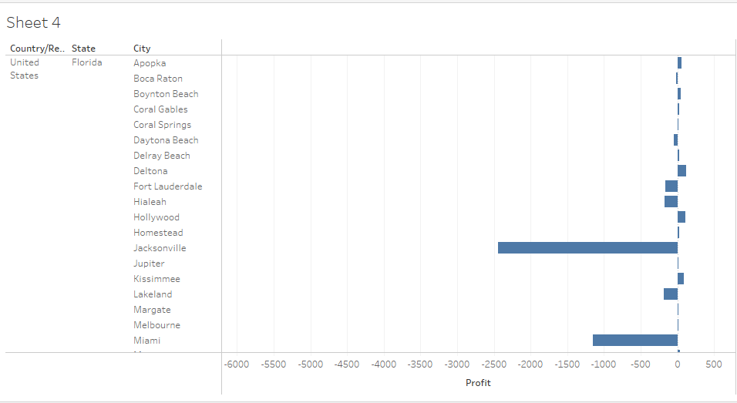
On the Rows shelf, click the plus icon on the State field to drill-down to the City level of detail.

Slide 5
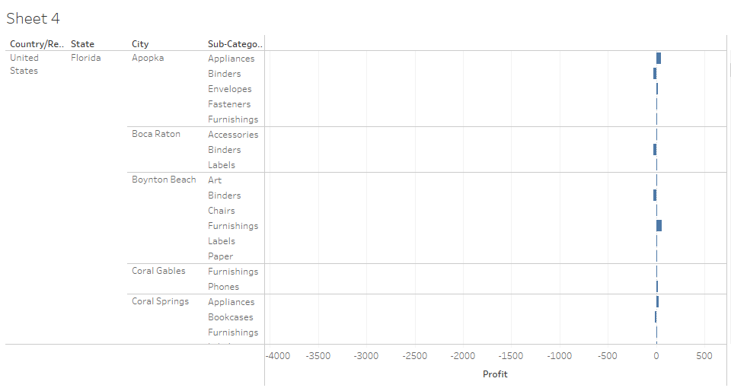
how profit subcategory wise for all the states and city having negative profit.

Slide 6
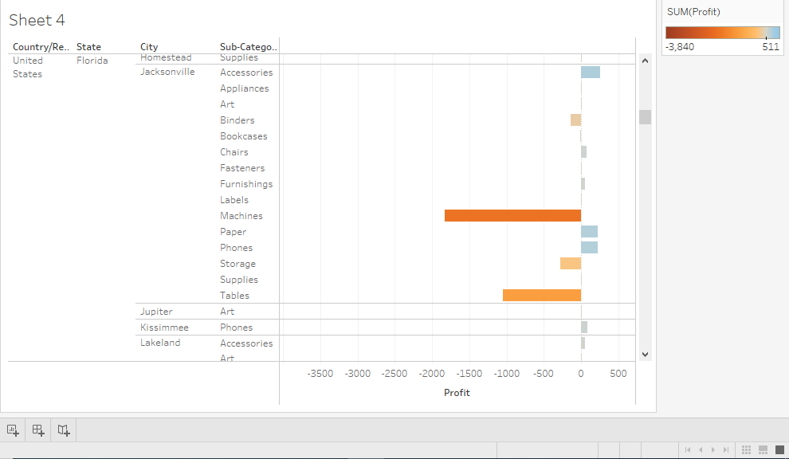
Show the profit in different colour.

Slide 7
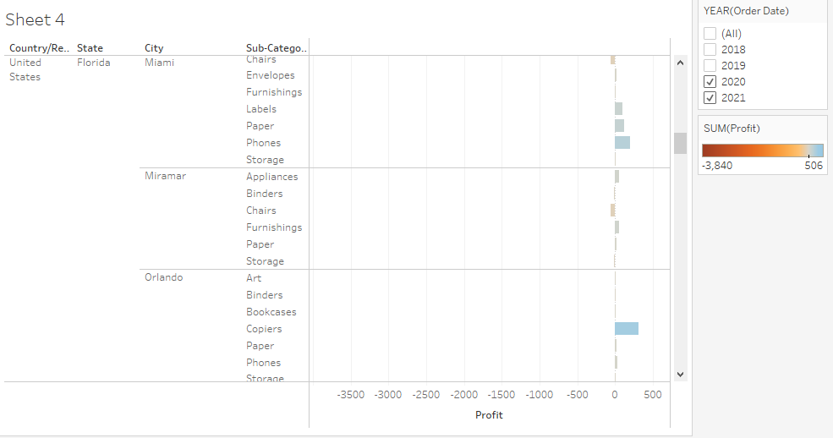
Check the profit in 2020 & 2021

Slide 8
Find some meaningful information and suggest how can we increase the profit
Machine Binders and tables the are product which need to be focused the most to increase the profit in all the states.
Phones has been the best sale in all the states from last two years and expected to increase in the upcoming years.

